Slide 1

Inference
Sampling Distributions
Adriano Zambom

Slide 2
Parameters and Statistics
Parameter is a number that is a summary characteristic of a population.
Statistic is a number that is computed from a sample of values taken from a larger population.
Sample estimate or estimate is used for a sample statistic when the statistic is used to estimate the unknown value of the population parameter.
Adriano Zambom

Slide 3
Statistical Inference
Statistical Inference procedures are procedures we use for making conclusions about population parameters based on sample statistics
1. Hypothesis Testing
2. Confidence Intervals
Adriano Zambom

Slide 4









Big Five Parameters
Parameter Name | Population Parameter | Statistic
Categorical
One population proportion | p
Difference in two population proportions
Quantitative
One population mean
Population mean of paired differences
Difference in two population means
Adriano Zambom

Slide 5
Sampling Distribution
The sampling distribution for a statistic is the probability distribution of possible values of the statistic for repeated samples of the same size taken from the same population
Adriano Zambom

Slide 6
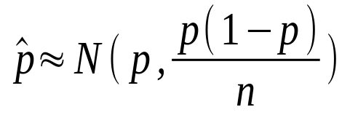
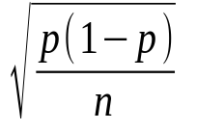
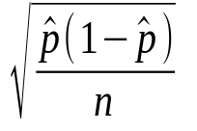


One Sample Proportion
Example: What’s the proportion of people who are right handed in the US?
  In the random sample of 10,000 we find 6200 right handed.
p: pop proportion : sample proportion
The distribution of possible values of is approximately a normal distribution with
Mean = p
Standard deviation = sd( ) =
The approximate normal distribution is called the sampling distribution of
In practice p is unknown. Therefore we estimate
the standard deviation using the standar error. s.e.( ) =
Conditions: and
Adriano Zambom

Slide 7




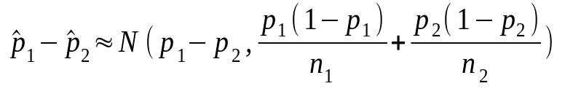
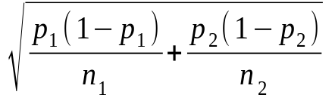



Difference in two Sample Proportions
Example: What is the difference in proportions of being in favor of Death Penalty for men and women? We find 3000 men and 2000 women in favor, from a sample with 10000 and 11000 women
Population Sample
proportion of men in favor proportion of men in favor
proportion of women in favor proportion of women in favor
difference in proportion difference in proportion
The sampling distribution for the diﬀerence of two sample proportions is approximately normal with
Mean =
Std. dev. =
Conditions:
Adriano Zambom

Slide 8


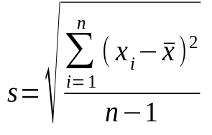
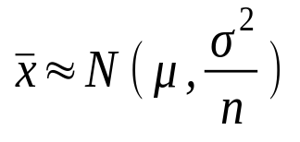
One Sample Mean
Example: What is the mean price of cars in Canada? Suppose we observe 3 cars with prices 10000, 11000 and 12000.
Pop. Mean = Std.dev.( ) =
Sample mean = s.e. ( ) =
Recall:
The sample distribution of the sample mean is approximately normal with mean and std.dev. , i.e.,
Conditions:
  a) large sample size or bell-shaped distributions
Adriano Zambom

Slide 9






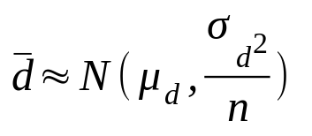
Sample Mean of Paired Differences
Example: We give drug A on Sunday to 200 people and measure their strength; give drug B to the same people on the following Sunday and measure strength again.
difference in the two measurements for person i
mean for the population of differences
standard deviation for the population of diﬀerences
mean for the sample of diﬀerences s.d( ) =
standard deviation for the sample of diﬀerences s.e.( ) =
Sampling distribution of is approximately normal with mean and standard deviation , i.e.,
Conditions:
  a) large sample size or bell-shaped distributions
Adriano Zambom

Slide 10




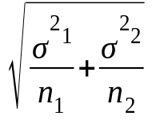
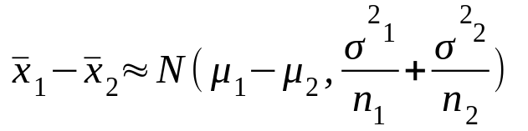
Difference in Two Sample Means
Example: who are the fastest drivers? Is there a difference in means?
Sample: 87 M, 102 F.
=107, = 88, =17, =14
Population difference:
Sample difference:
The sample distribution of is approximately normal with
mean and std.dev. , i.e.,
Conditions:
  a) large sample size or bell-shaped distributions for both
Adriano Zambom

Slide 11
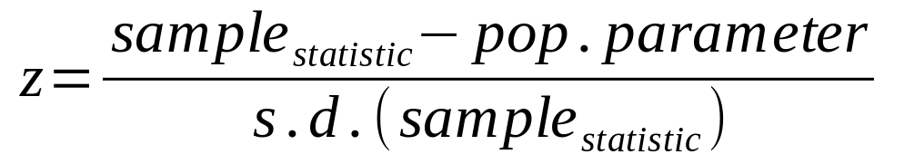
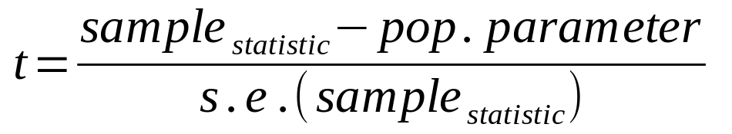
Standardized Statistics
When we know the population standard deviation
When we don’t know the population standard deviation
Adriano Zambom

Slide 12
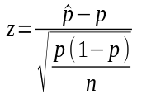
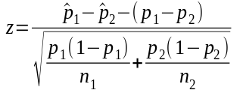
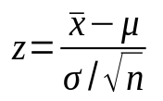
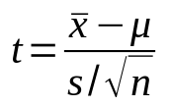
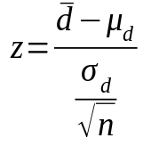
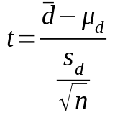
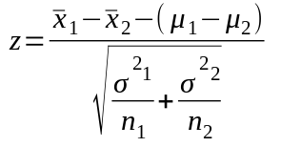
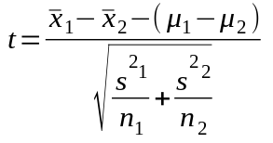
Standardized Statistics
Parameter Name | Population Parameter | Statistic | z-score | t-score
Categorical
One population proportion | p
Difference in two population proportions
Quantitative
One population mean
Population mean of paired differences
Difference in two population means
Adriano Zambom

